Slide 1
Negative effects of allelopathic plant invasion accumulate as the growth season progresses
Evan A. Perkowski, K. Carroll¹, Jessie Mutz², Snehanjana Chatterjee¹, Xianyu Yang³, Lalasia Bialic-Murphy^{2,3}, Stephanie N. Kivlin², Susan Kalisz², Nicholas G. Smith¹

Slide 2
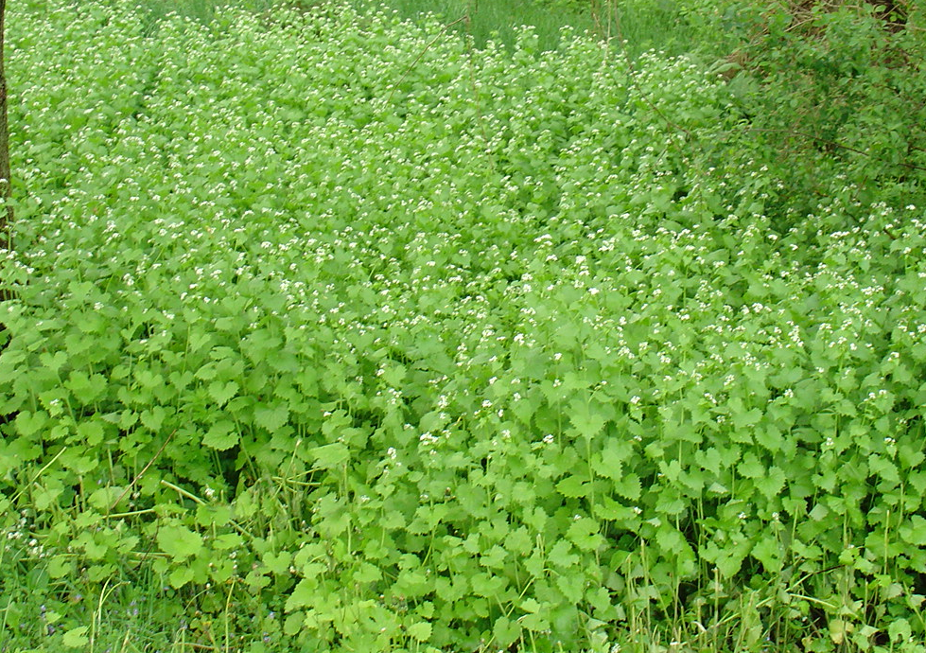
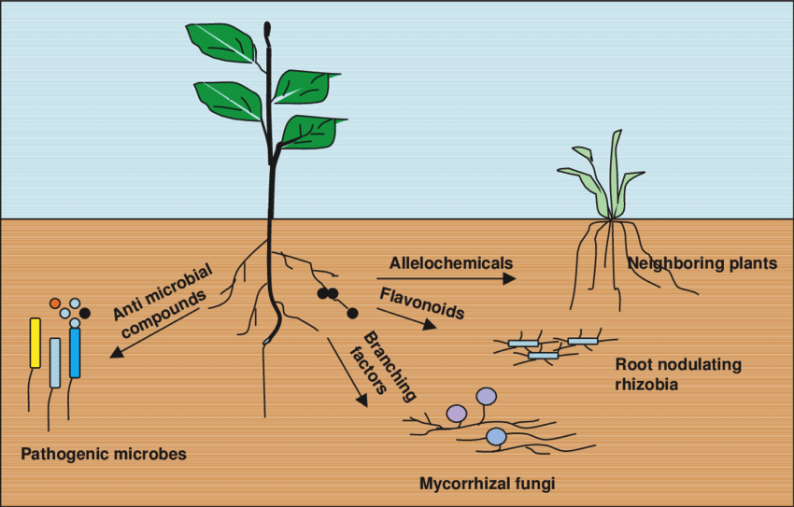
Invasive species exploit strategies that maximize fitness in novel environments
Decreasing available light
to neighbor plants
Producing compounds that are toxic to
soil microbes and neighbor plants
Notes:
Early emergence to take advantage of soil resources
Used to increase vertical growth and shade out neighboring species
Used to produce secondary metabolites that are toxic to neighboring roots or soil microbial communities that play a large role in regulating nutrient biogeochemical cycles

Slide 3
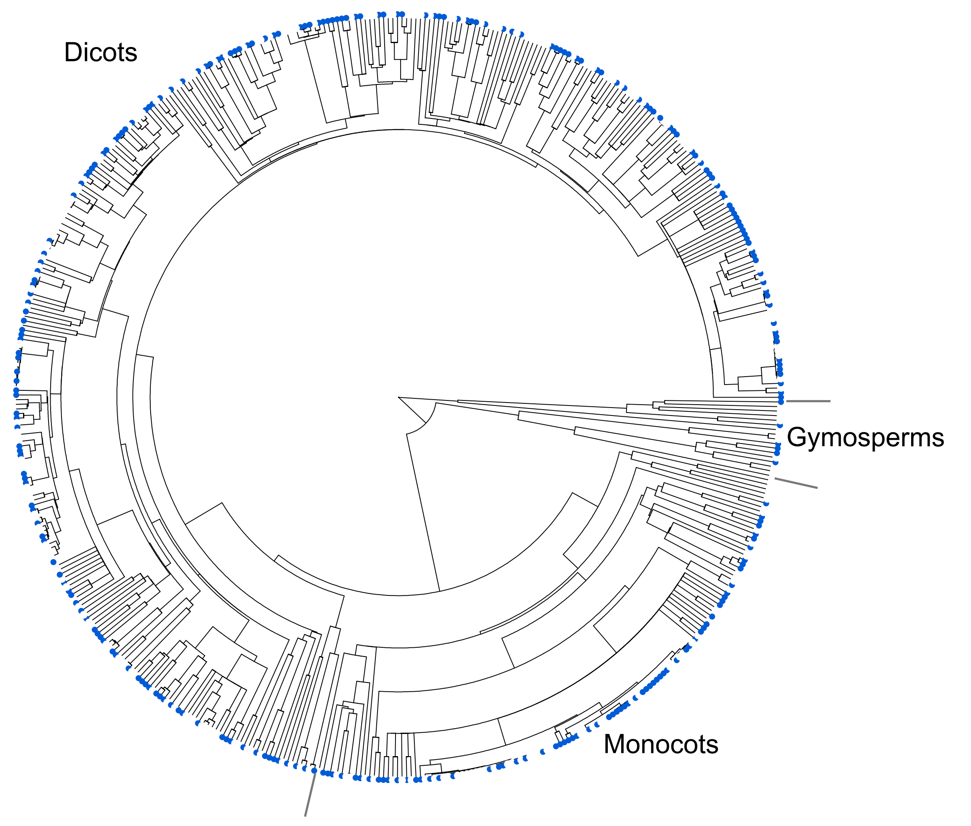
Allelopathy is common among invasive plant species
52% of surveyed invasive species
(n=526 species) had allelopathic
capabilities!
allelopathic invasive species
non-allelopathic invasive species
Kalisz et al. (2021) Biological Invasions
Notes:
Allelopathy is a secondary compound released through root exudation or leaf litter that negatively affects neighboring plant communities

Slide 5
Hypotheses
Photosynthetic capacity
Leaf-level carbon assimilation
Stomatal conductance
Predicted positive effect
Predicted negative effect

Slide 6
Hypotheses
Photosynthetic capacity
Garlic mustard presence
Leaf-level carbon assimilation
Stomatal conductance
Predicted positive effect
Predicted negative effect

Slide 7
Hypotheses
Negative effects of garlic mustard may be strongest early in growth season
when demand to build and
maintain photosynthetic
enzymes are high
Photosynthetic capacity
Garlic mustard presence
Leaf-level carbon assimilation
Stomatal conductance
Predicted positive effect
Predicted negative effect

Slide 8
Hypotheses
Negative effects of garlic mustard may be strongest early in growth season
when demand to build and
maintain photosynthetic
enzymes is highest
Photosynthetic capacity
Garlic mustard presence
Leaf-level carbon assimilation
-or-
Negative effects of garlic mustard may be strongest later in growth season
when resource availability is depleted and reliance on AM fungal partners is greatest
Stomatal conductance
Predicted positive effect
Predicted negative effect

Slide 9
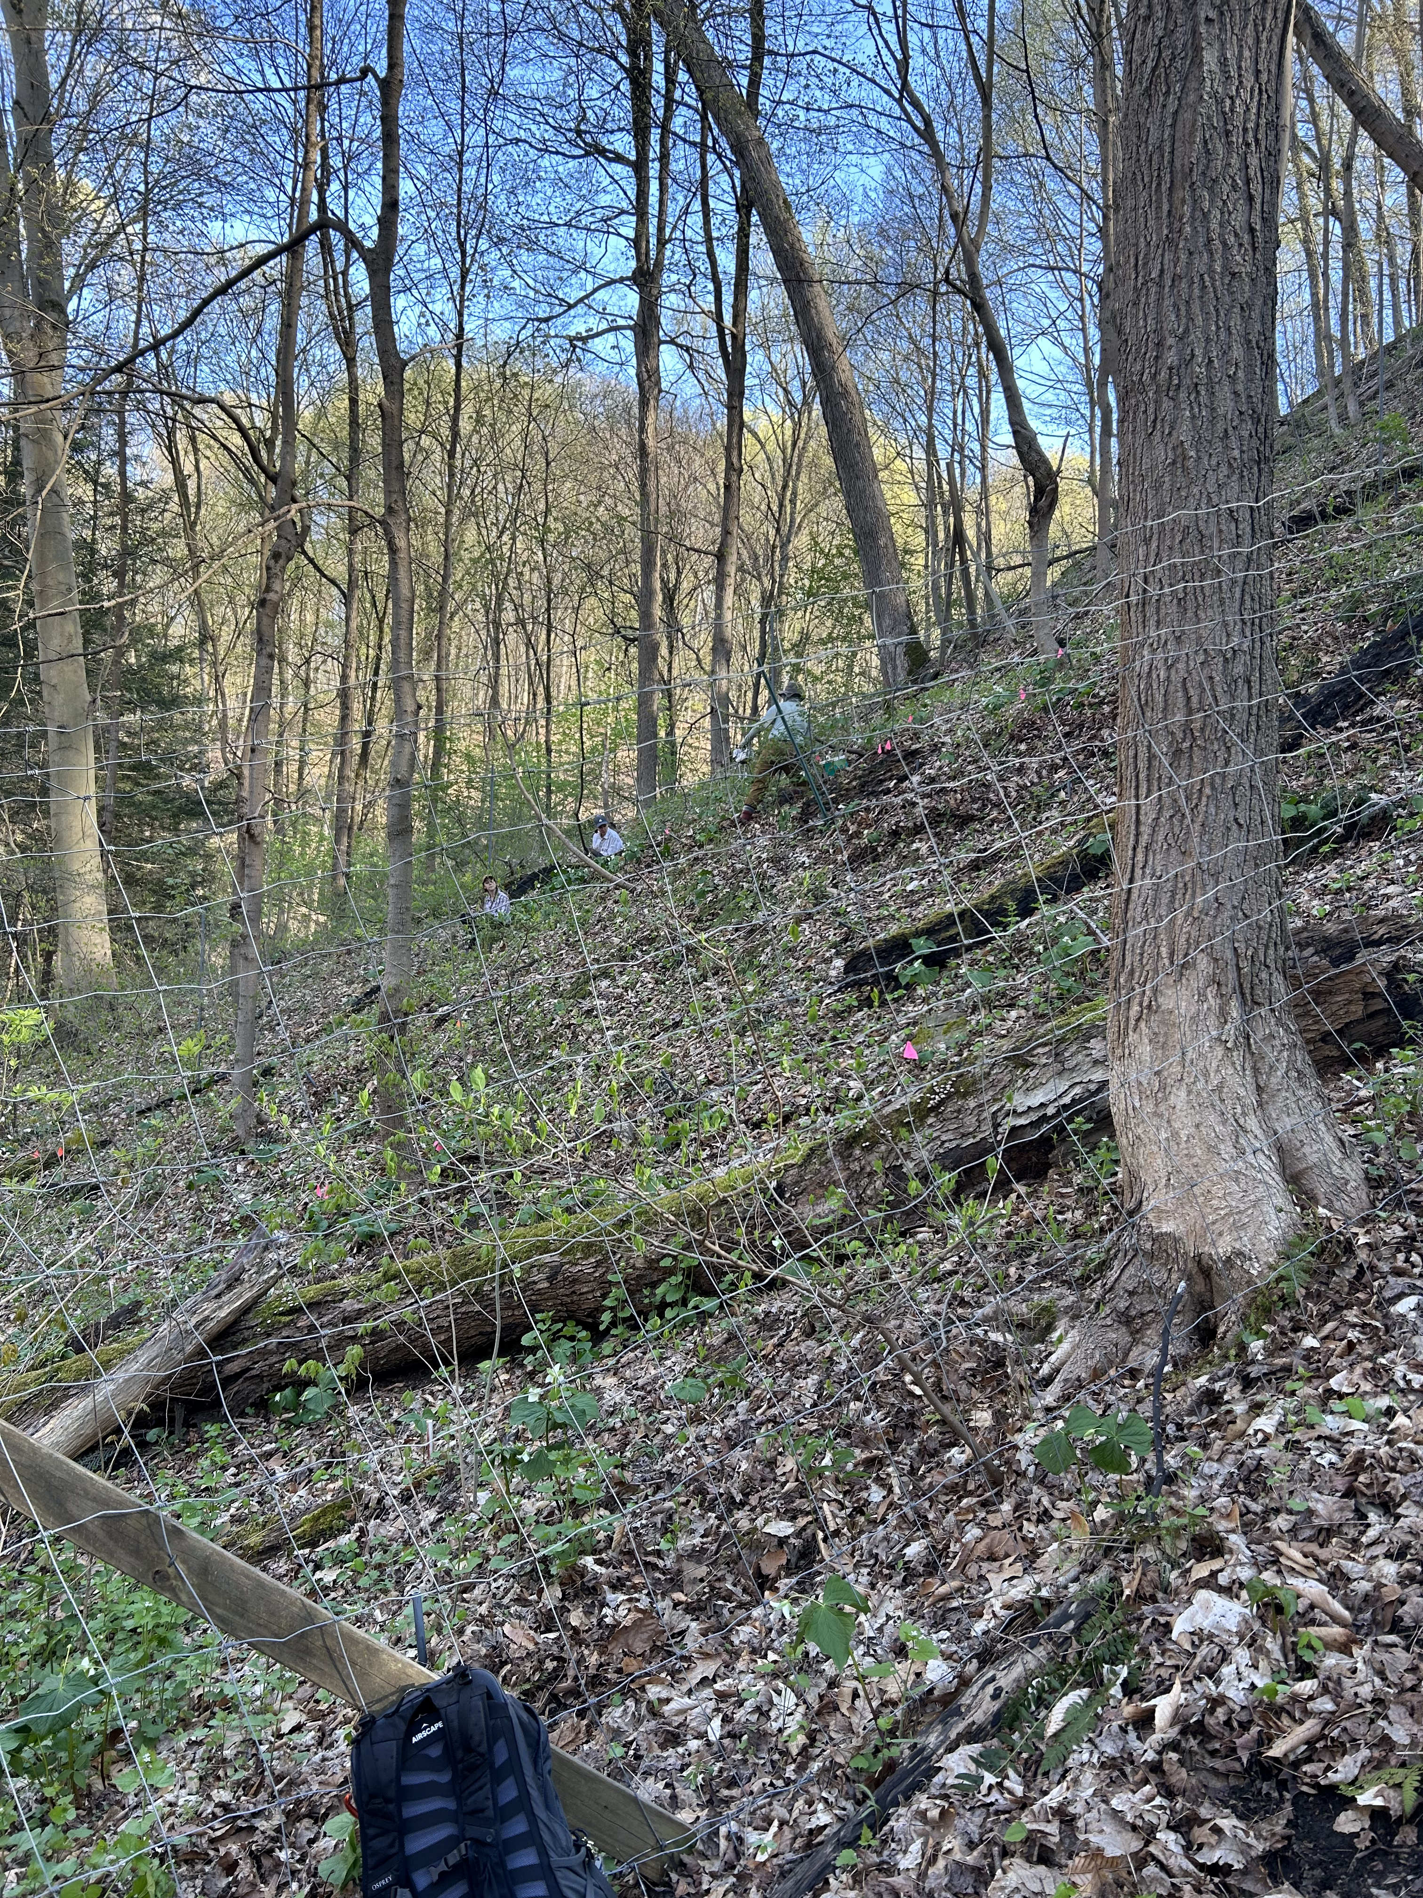
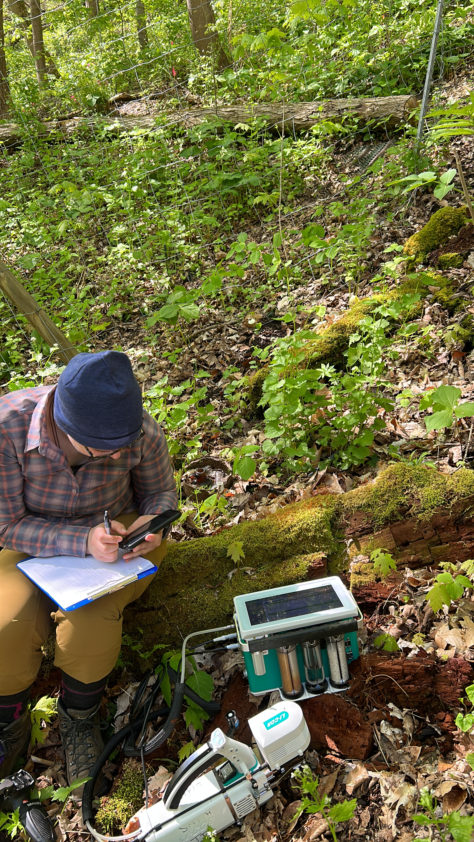
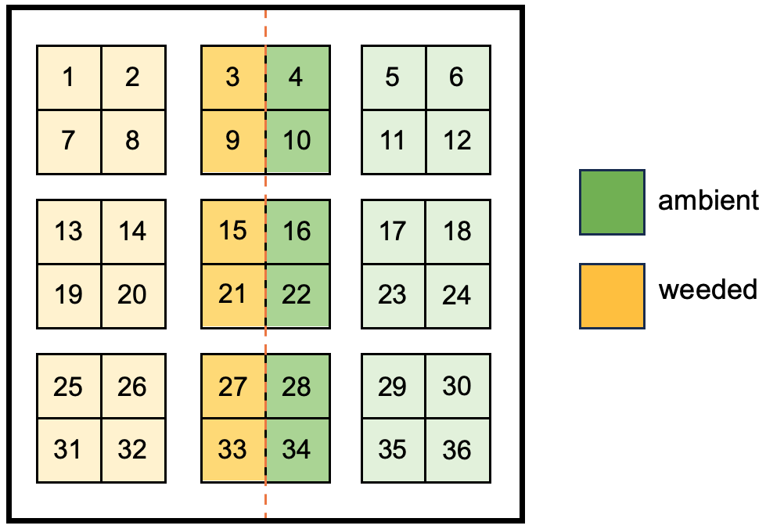
Long-term Alliaria weeding experiment
Fencing established in 2002 to ward out deer/macro-herbivores
Manual garlic mustard weeding in half of each plot since 2006

Slide 10
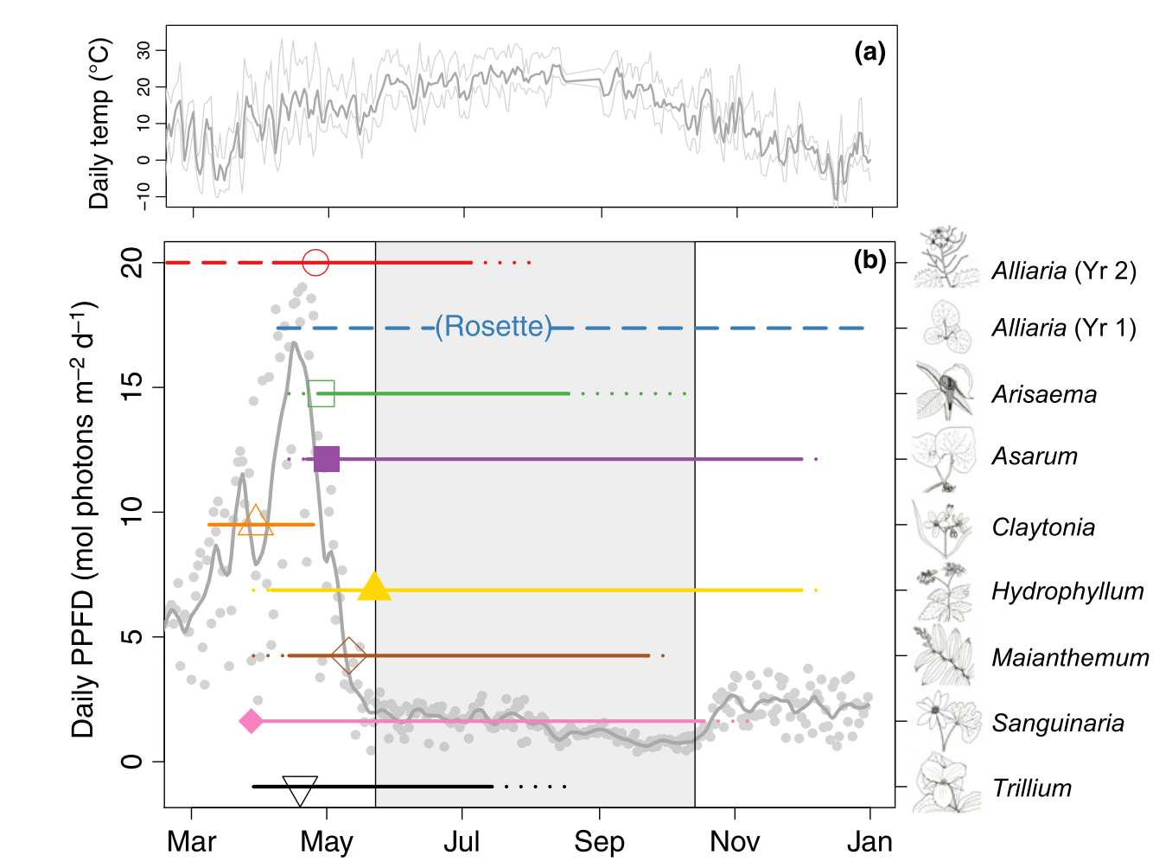
Heberling et al. (2019)

Slide 11
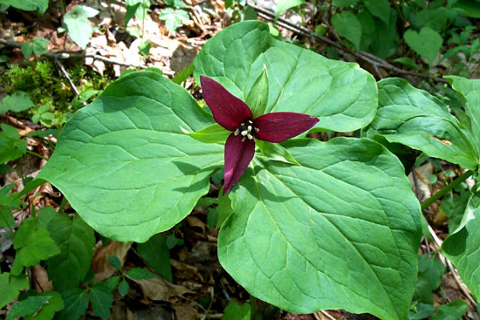
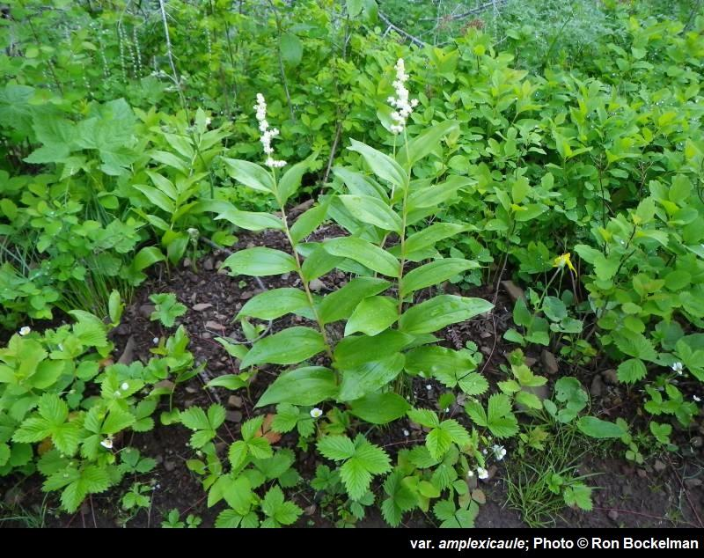
Heberling et al. (2019)
Trillium spp.
Maianthemum racemosum

Slide 12
Heberling et al. (2019)
Trillium spp.
Maianthemum racemosum
second measurement period (closed tree canopy)
first measurement period (open tree canopy)

Slide 13
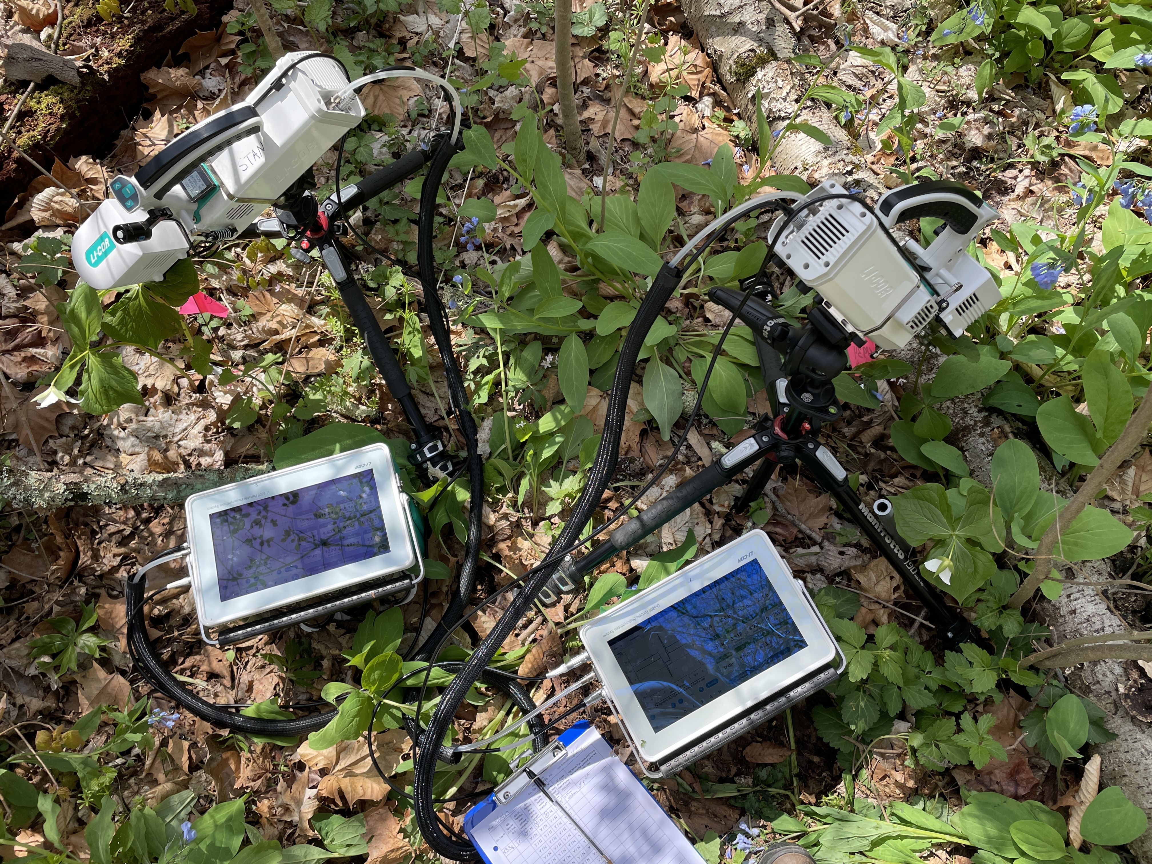
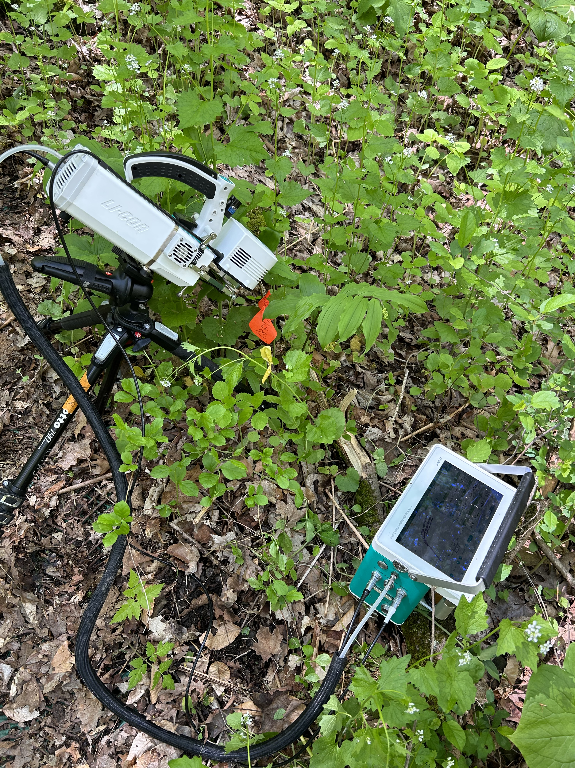
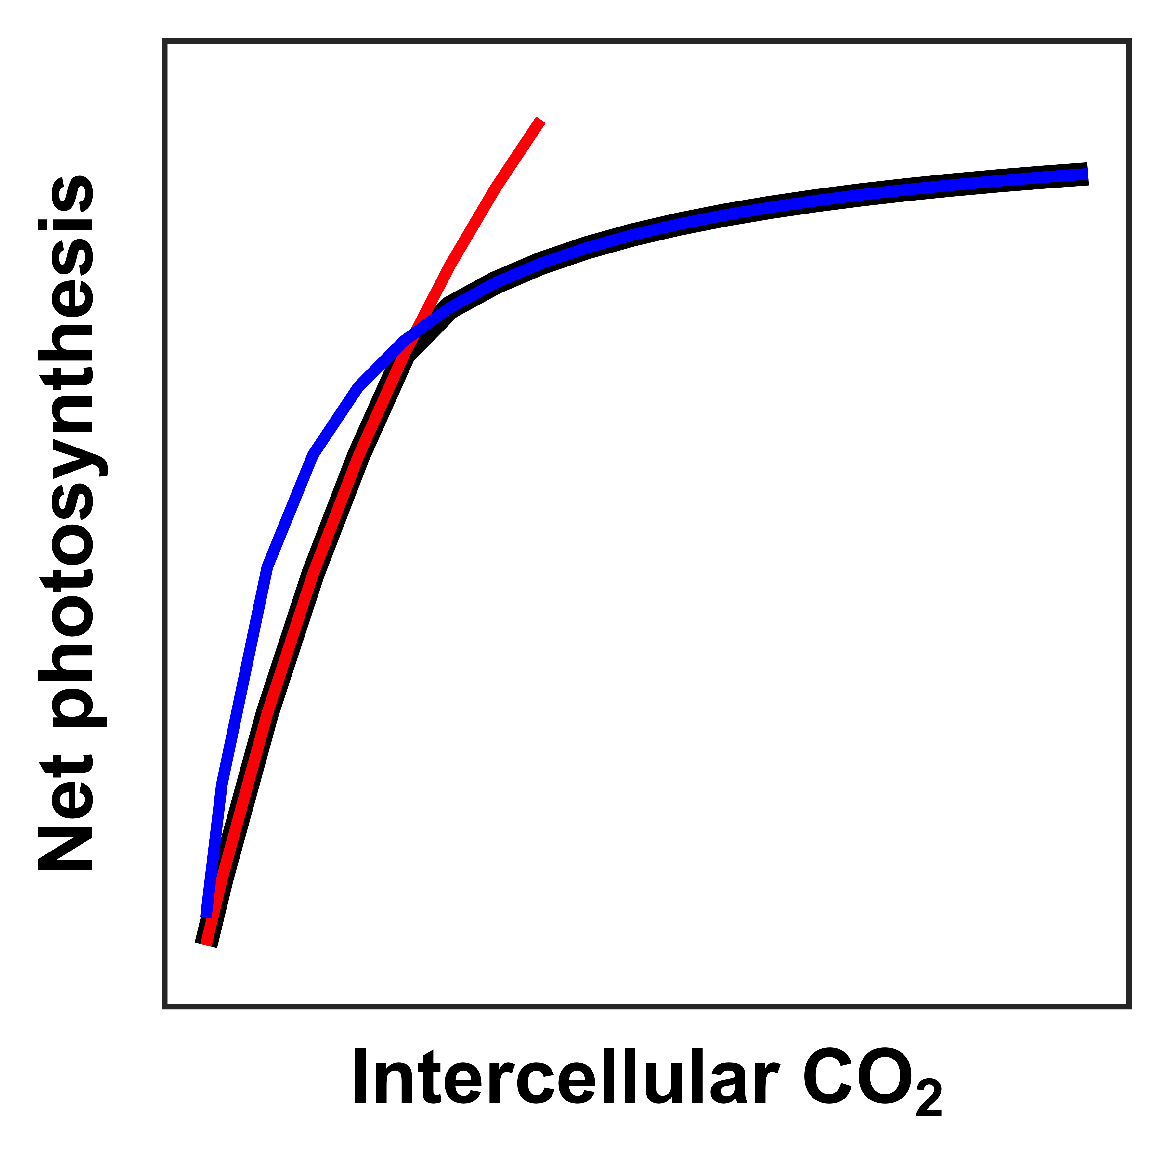
Field measurements
Soil resin sticks
Mobile ammonium, nitrate, and phosphate ions
CO₂ response curves
Maximum rate of Rubisco carboxylation (V_{cmax})
Maximum rate of electron transport for RuBP regeneration (J_{max})
Snapshot gas exchange measurements
x 2 measurement periods (open, closed tree canopy)

Slide 14
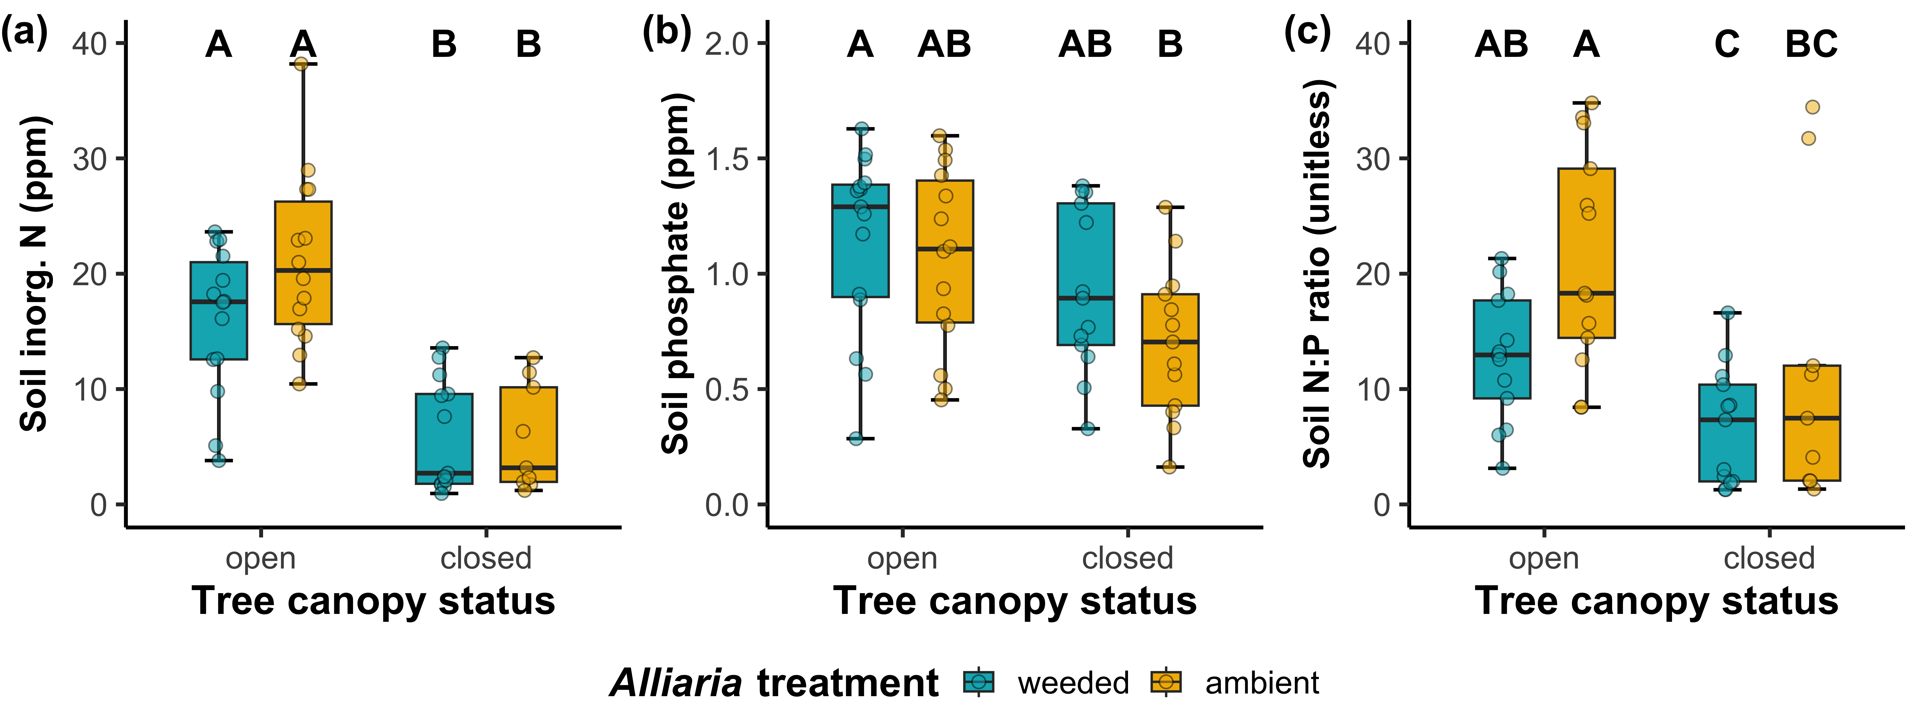
Soil nutrient availability is not affected by Alliaria presence regardless of measurement timepoint

Slide 15
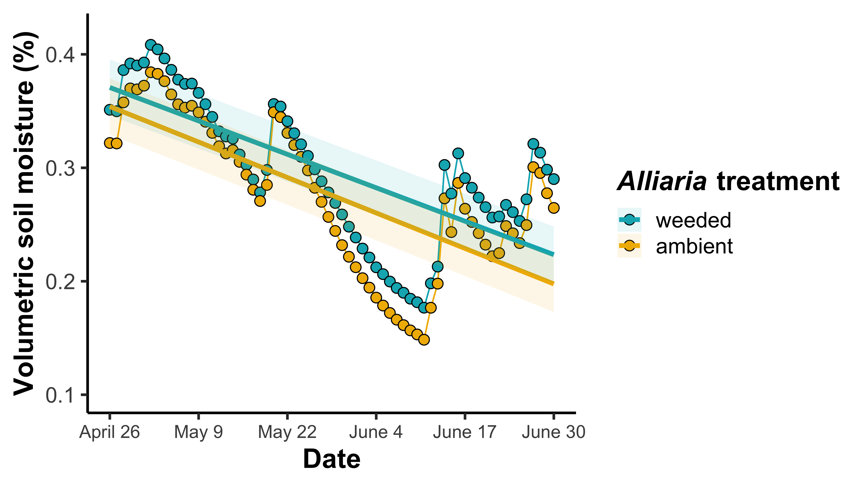
Alliaria presence is associated with reduced volumetric soil moisture

Slide 16
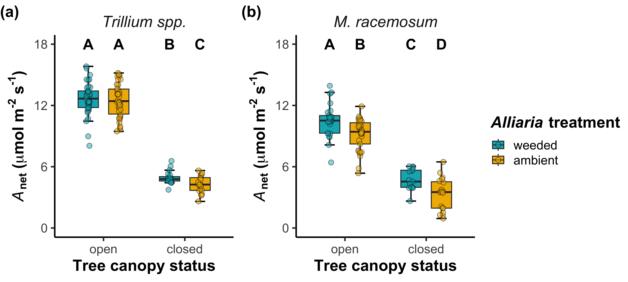
Alliaria presence decreased net photosynthesis rates in both species*
*stronger negative effects of Alliaria presence in both species after tree canopy closure

Slide 17
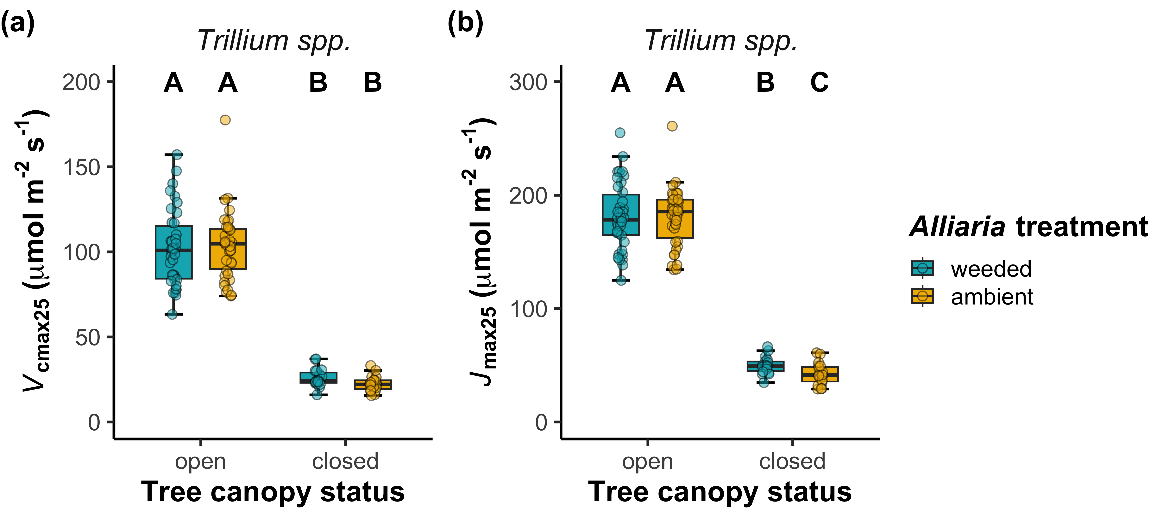
Photosynthetic responses to Alliaria in Trillium spp. were driven by changes to photosynthetic capacity
*stronger negative effects of Alliaria presence on J_{max25} after tree canopy closure

Slide 18
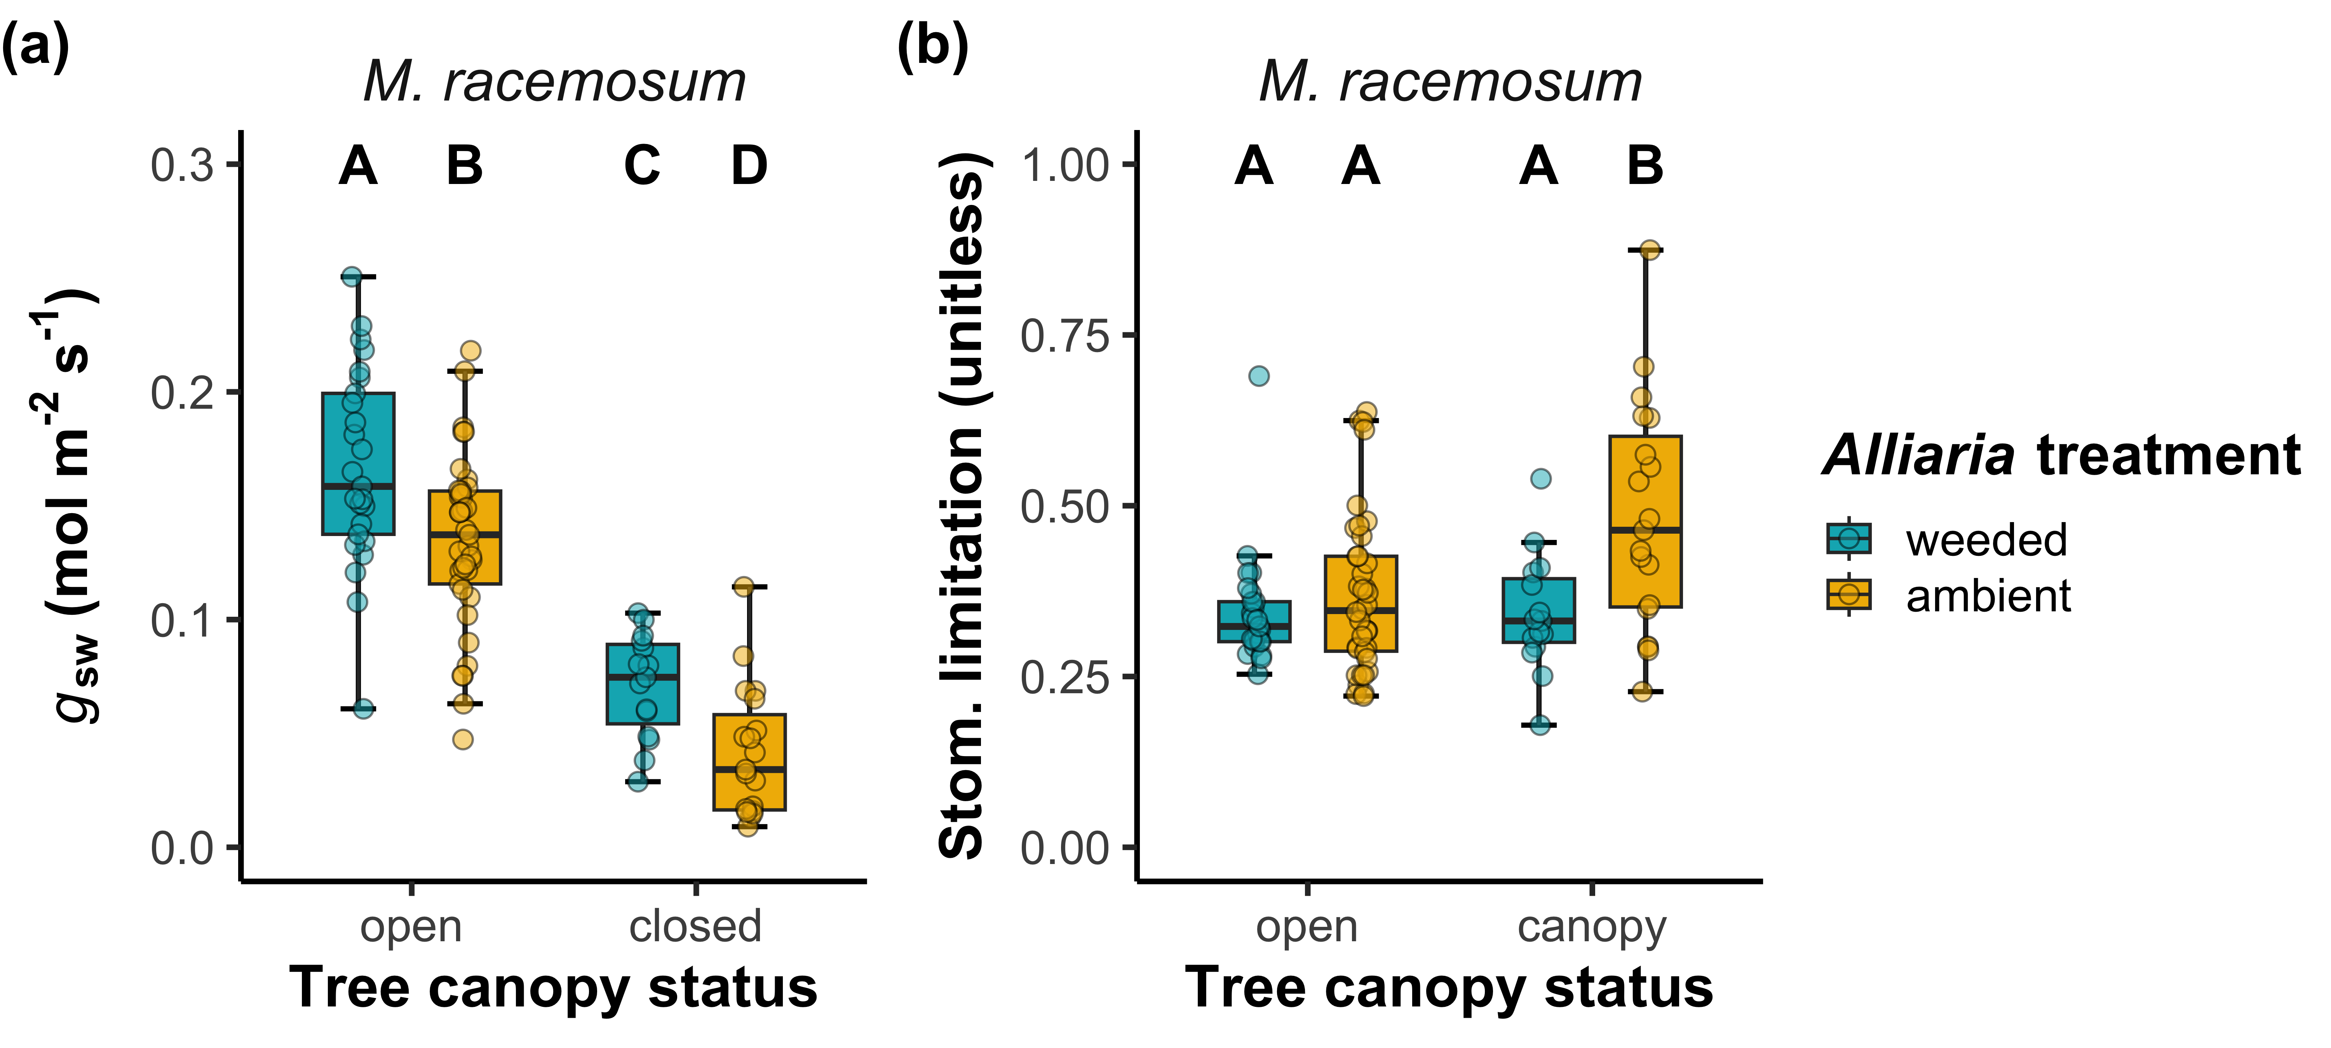
Photosynthetic responses to Alliaria in M. racemosum were driven by changes to stomatal conductance

Slide 19
Main takeaway #1: Alliaria decreased net photosynthesis in both species; however, the mechanisms driving these responses were species-specific
Photosynthetic capacity
Photosynthetic capacity
Garlic mustard presence
Leaf-level carbon assimilation
Garlic mustard presence
Leaf-level carbon assimilation
Stomatal conductance
Stomatal conductance
Positive effect
Maianthemum
racemosum
Trillium spp.
Negative effect

Slide 20
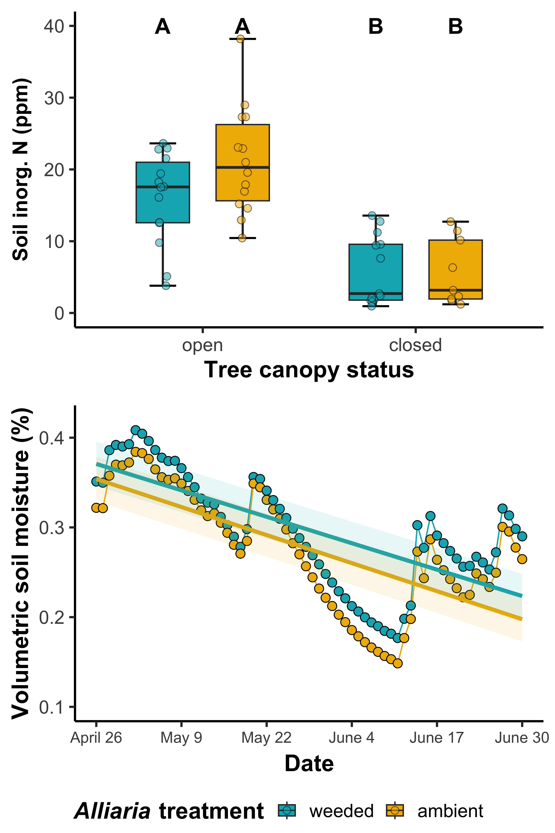
Negative effects of Alliaria on gas exchange increased in strength as the growth season progressed
Changes in resource availability may have increased reliance on disrupted AM fungal partners
Soil resources depleted as growth season progressed
Alliaria presence was associated with reduced volumetric soil moisture

Slide 21
Using leaf physiology to assess linkages between aboveground and belowground responses to allelopathic plant invasions

Slide 22
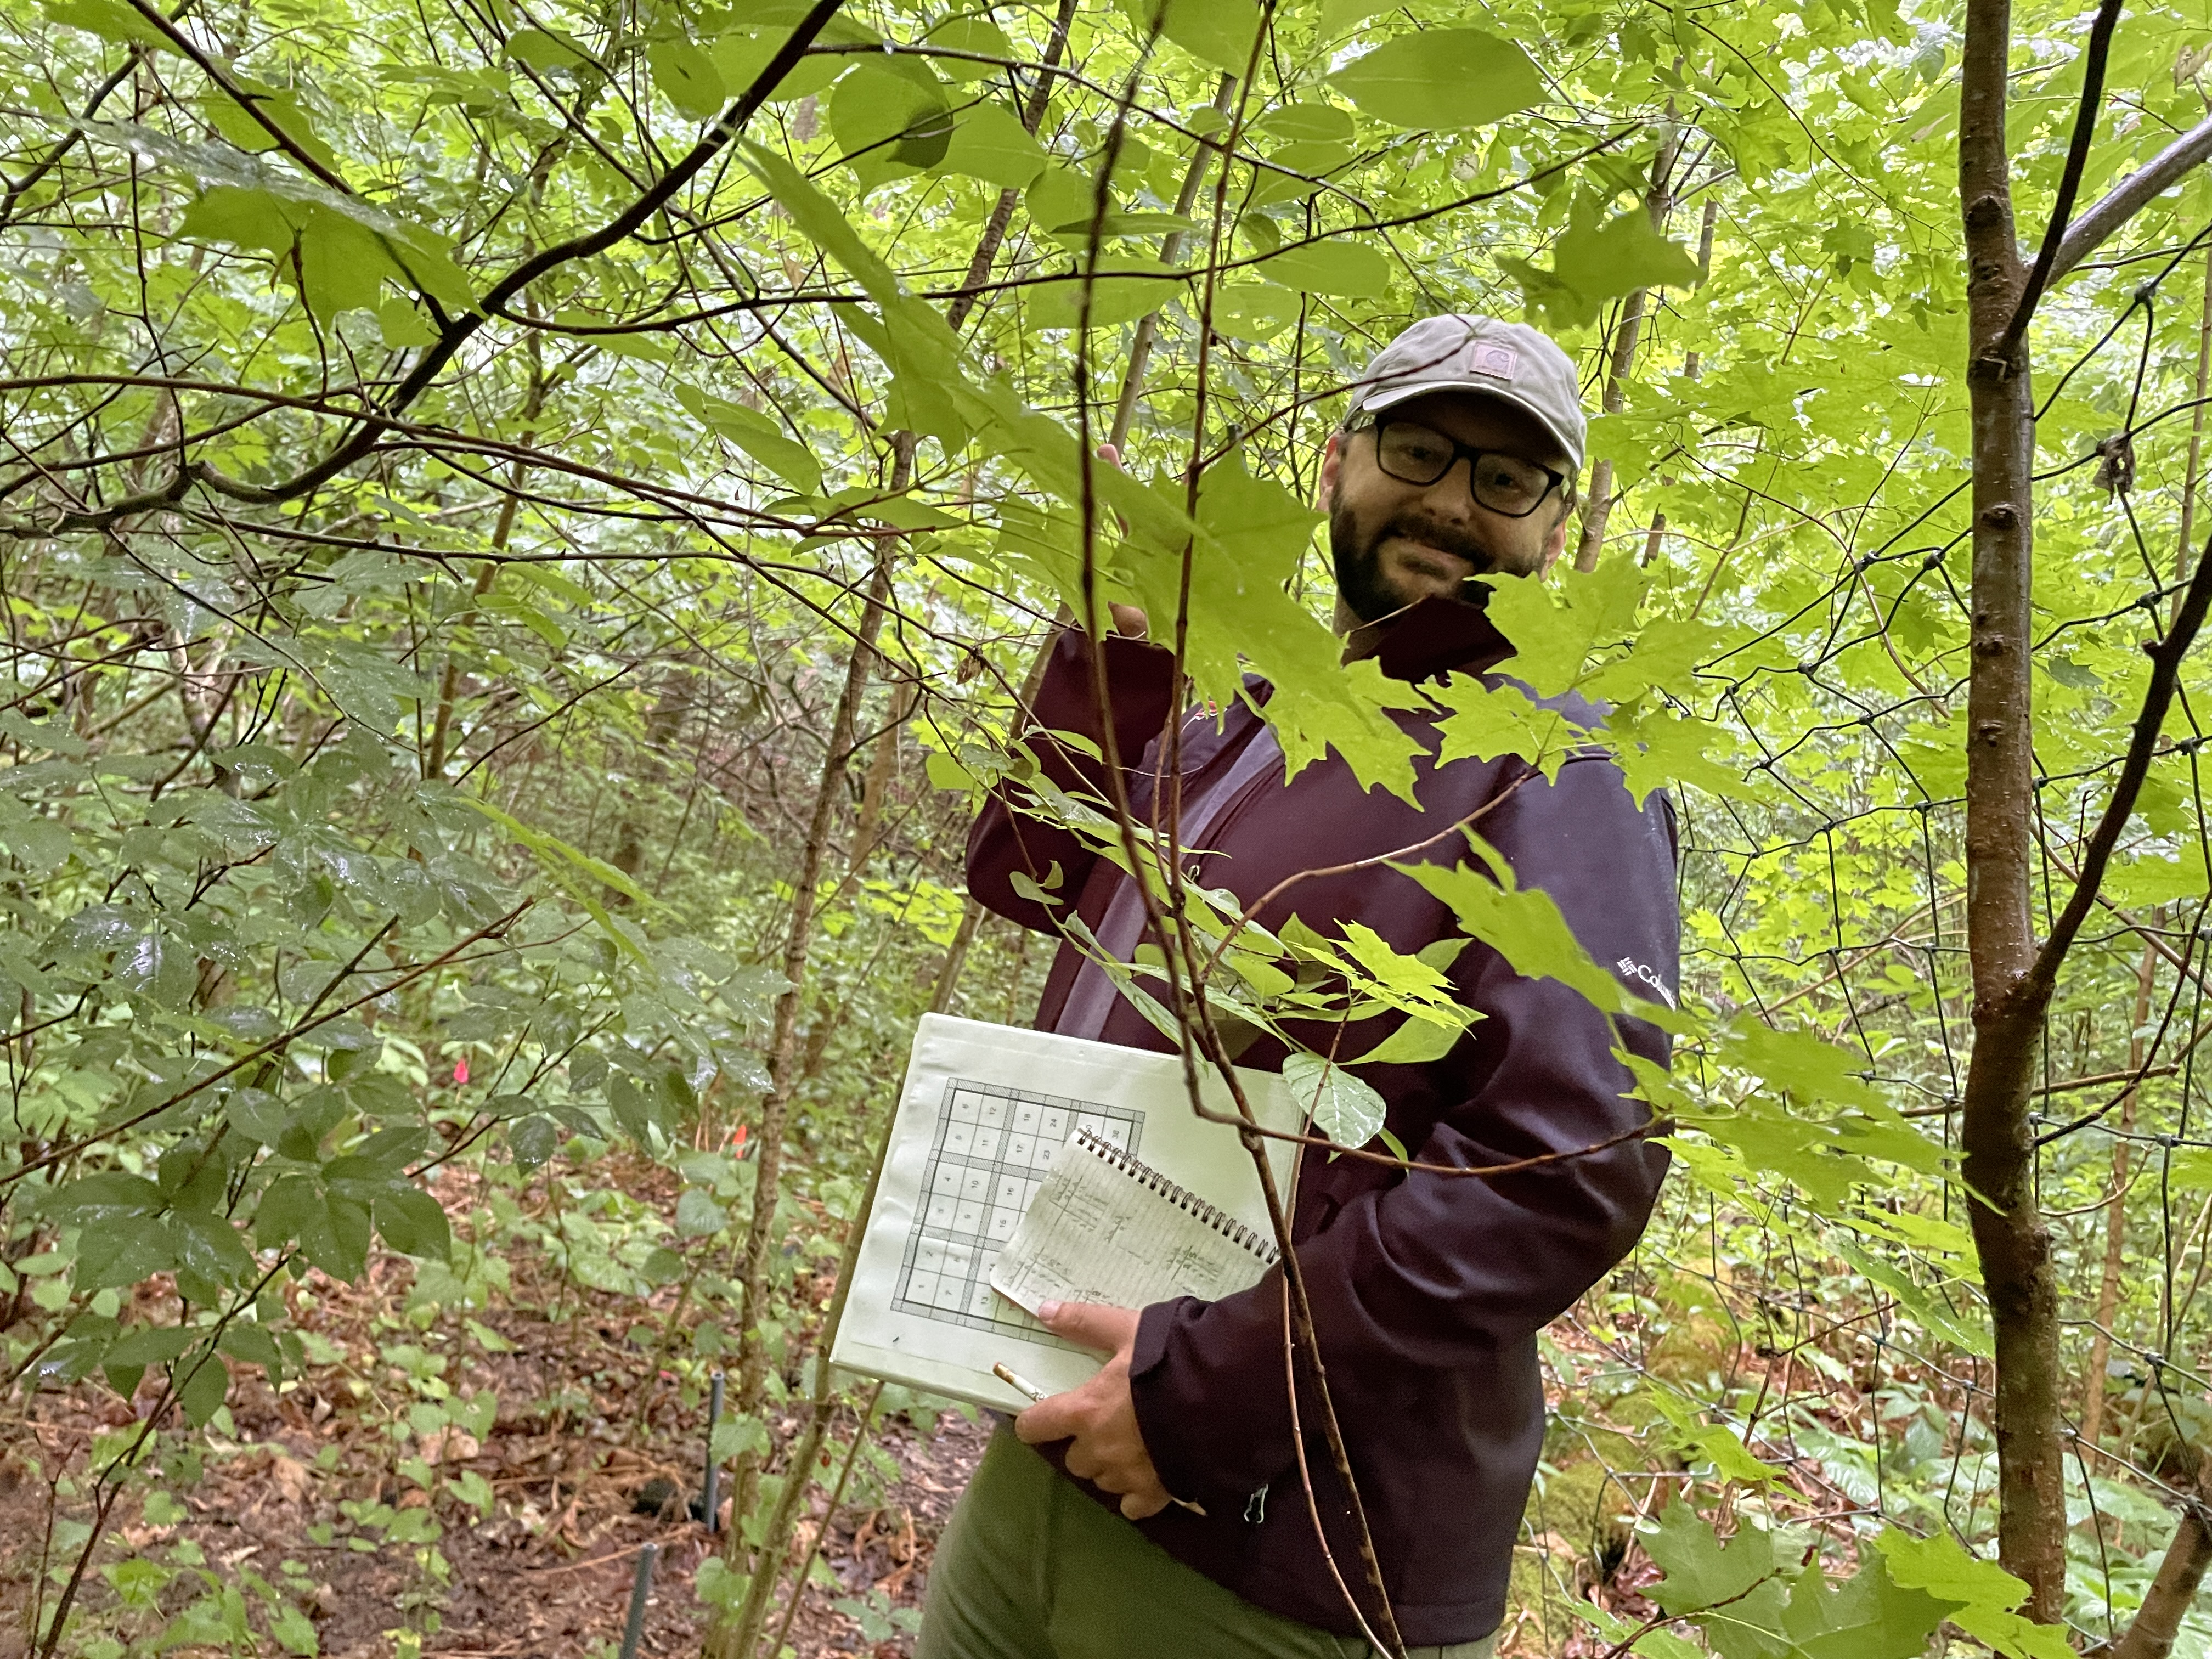
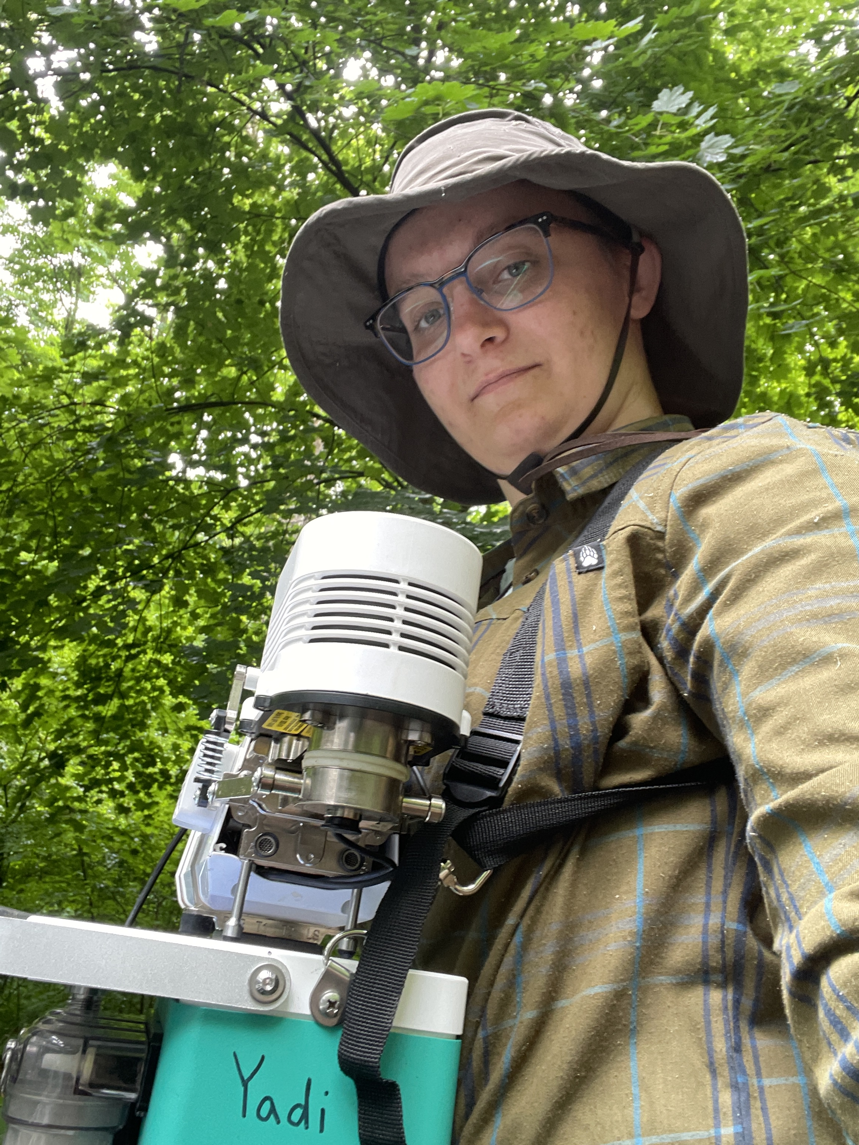
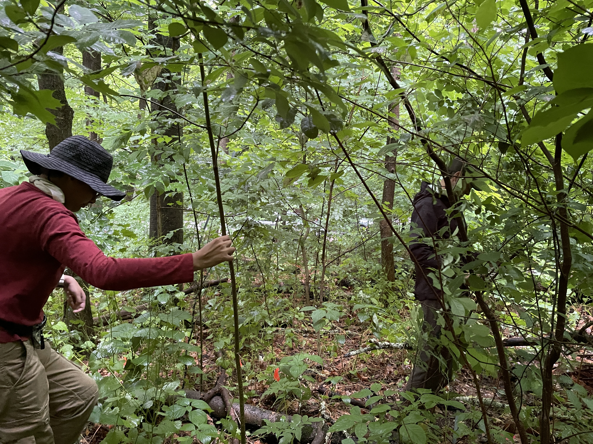
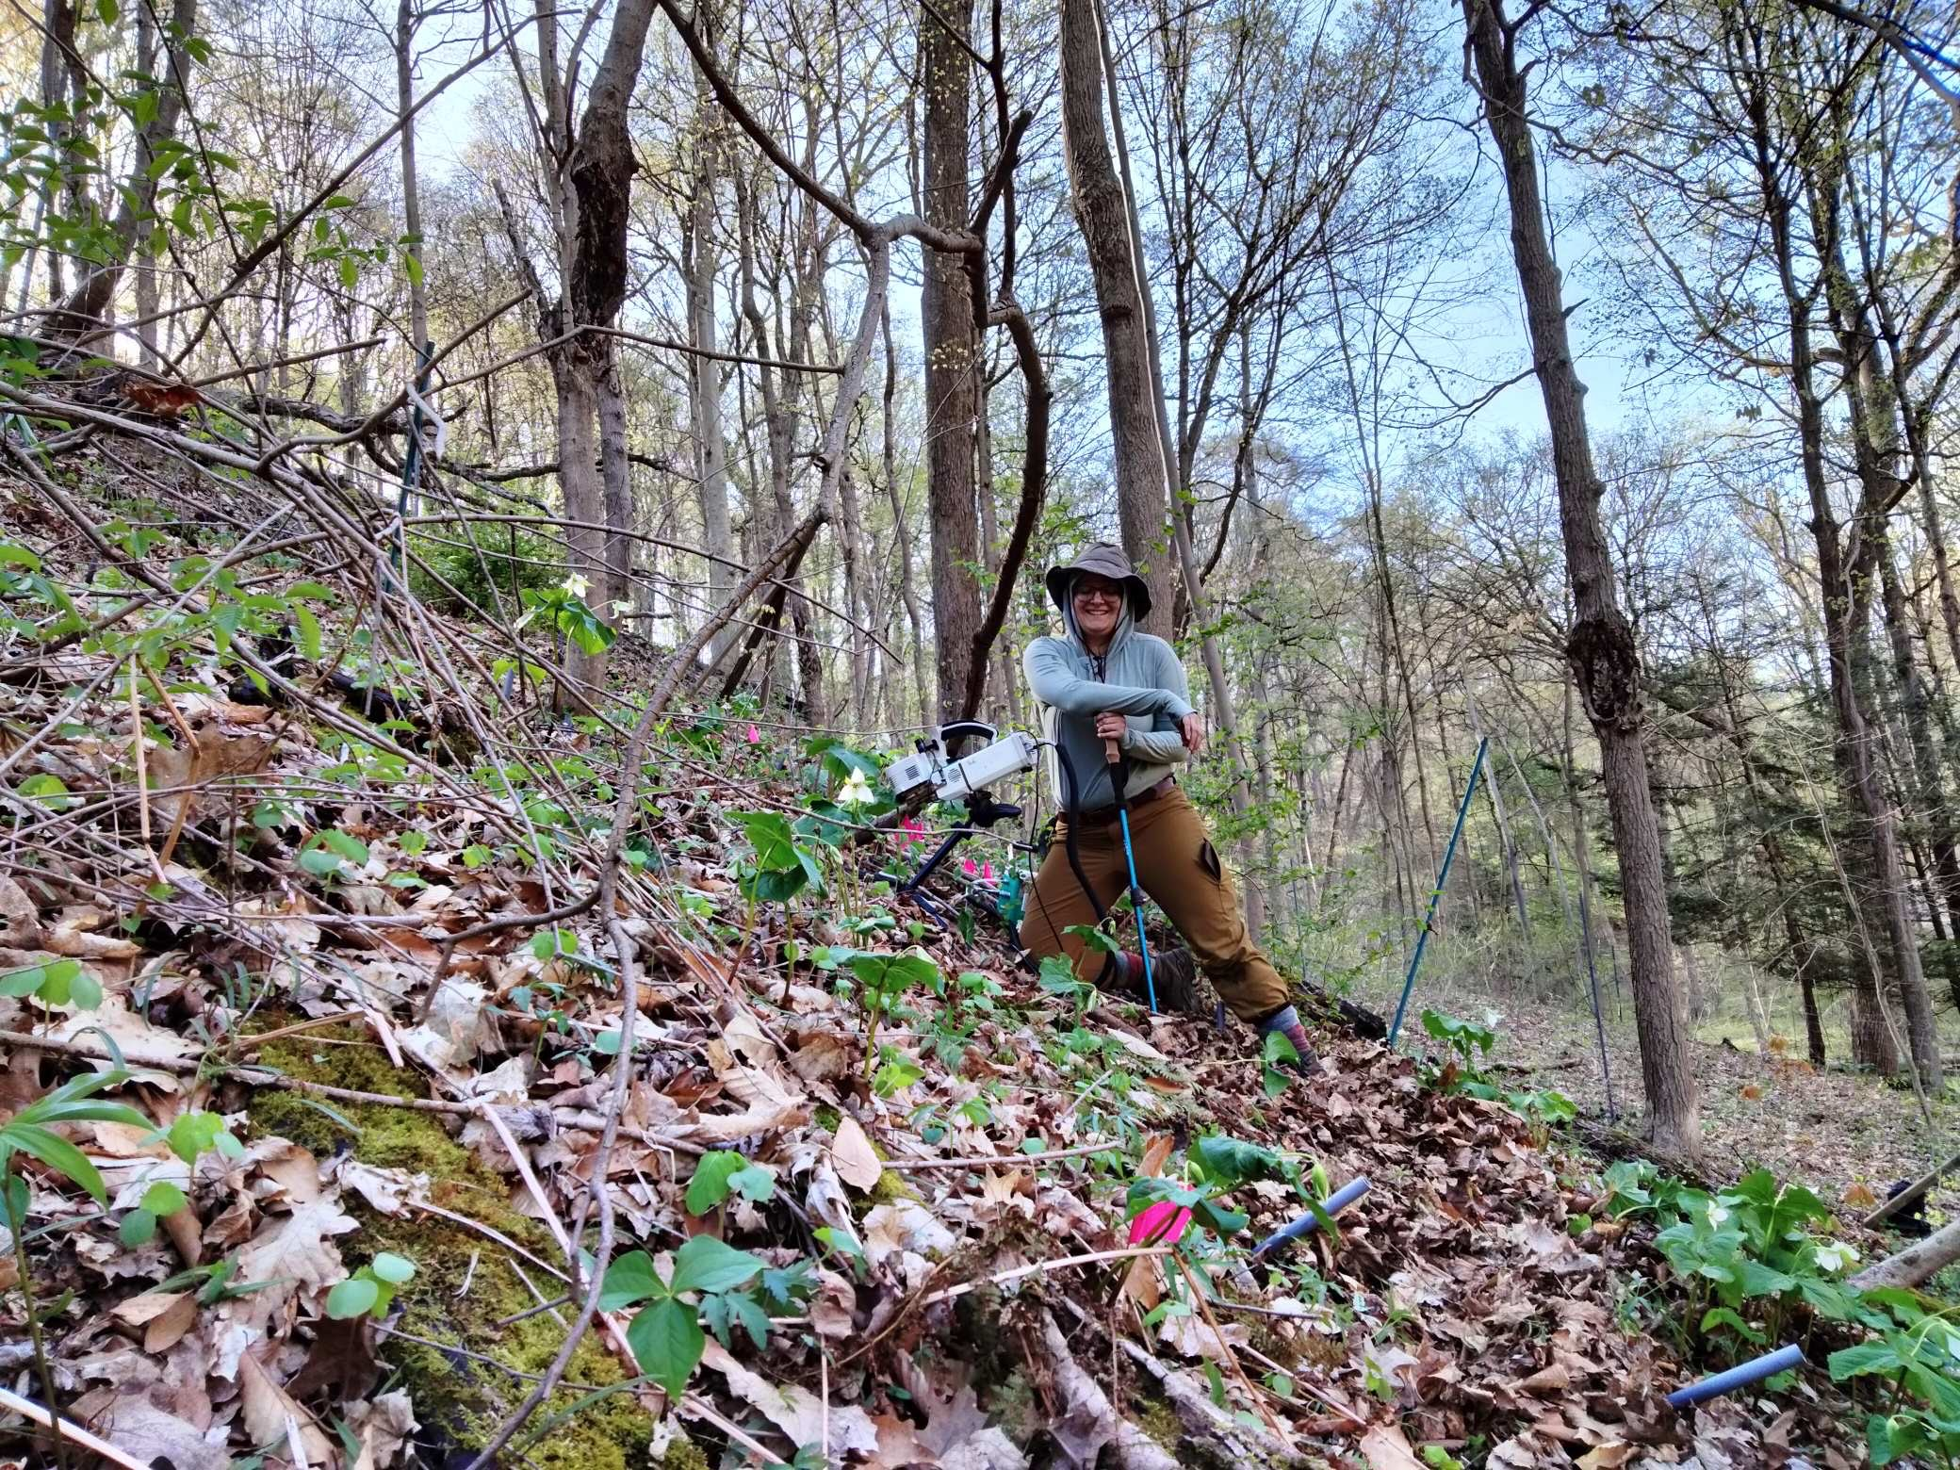
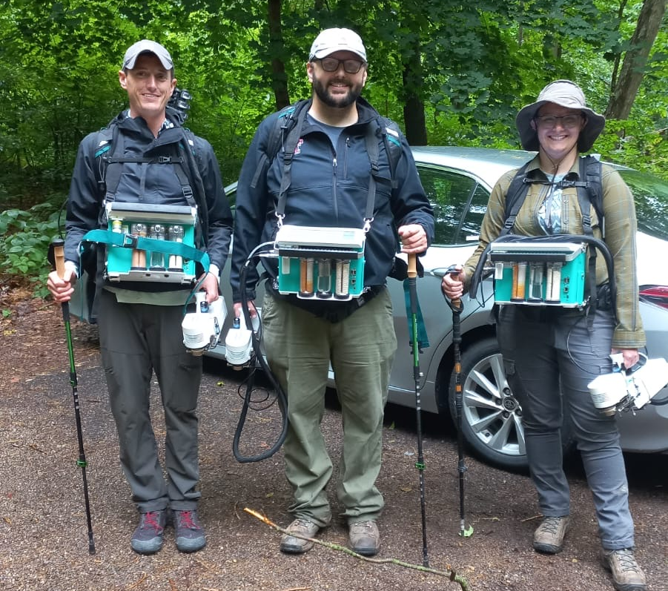
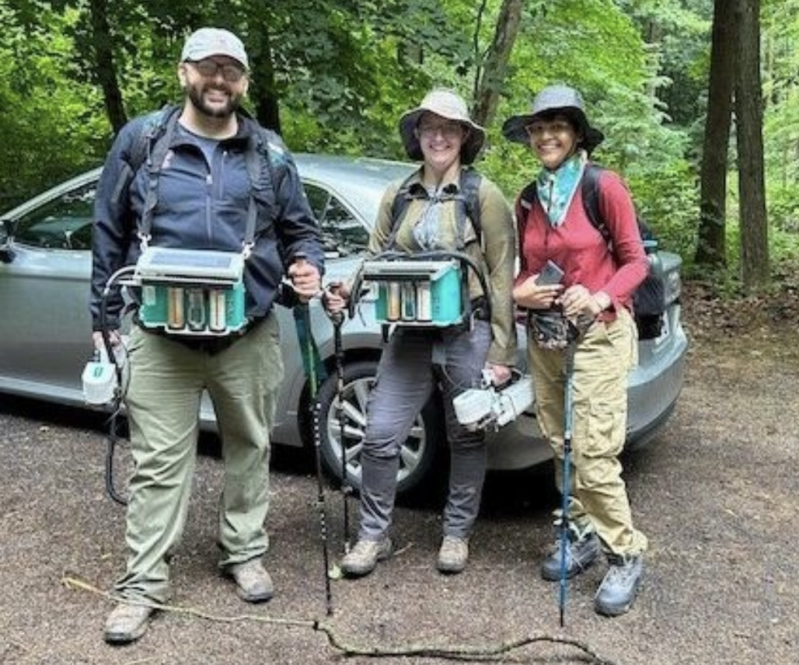
Acknowledgements

